Slide 1
Plant Management 2017
Reflective Journal Template
Procurement And Sales And Marketing
Name: Victor Olet
Student ID:18109704

Slide 2
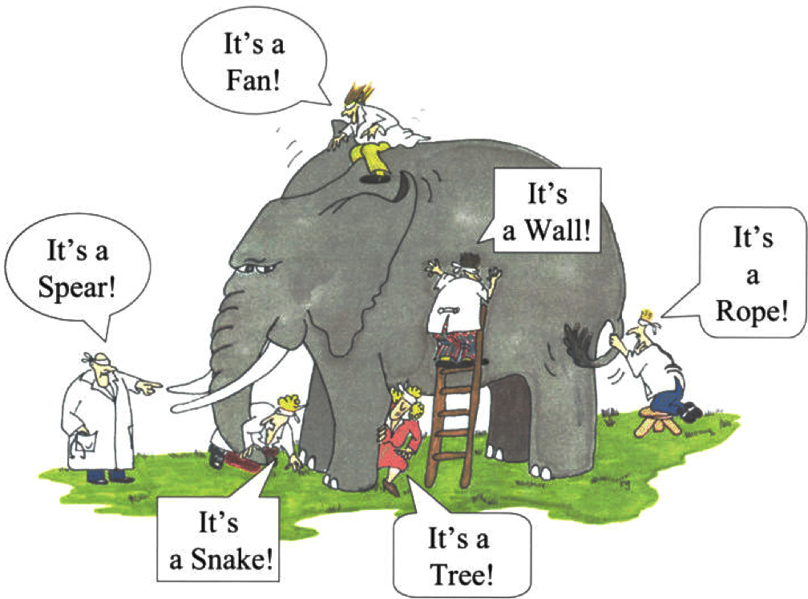
Procurement Sales And Marketing
Importance of wholistic view. What is an elephant? Who is a chemical engineer? (Firouz 2015)
1st point From hearing about Eugenia’s career pathway, I have been challenged to broaden my career expectations as a chemical engineer.
I have never thought of being a procurement engineer. Initially, I thought that procurement is not pertinent to chemical engineering, but she went on to explain how chemical engineering is quite necessary when procuring.
A particular example, was when she is doing trials for a new chemical, her knowledge of chemical engineering helps her analyse the product in the lab to prove whether it works as well as it was specified, or not. This is more comprehensive as opposed to just buying chemicals due to the seller’s promotion of the product alone.
2nd point One thing I have stopped doing is being too technical. I have always prided myself on being good in calculations, engineering software and scientific concepts. I have always thought that this is what defines a chemical engineer. But I realised I was only seeing one aspect of this profession, like the men describing the elephant in the figure above. After listening to Eugenia, I have learnt how important it is to blend technical skills with social skills in order to be successful at procuring, and at the workplace in general.
Also, I learned from Eugenia that being too technical can limit your career progress, as you can only do technical things. Expanding on non-technical skills might just give me the cutting edge in progressing upwards in the career ladder.
Reference
Firouz, Leila, "Knowing the Elephant: Mobbing Way," Red Badger, 2015, https://blog.red-badger.com/blog/2016/03/15/knowing-the-elephant-mobbing-way.

Slide 3
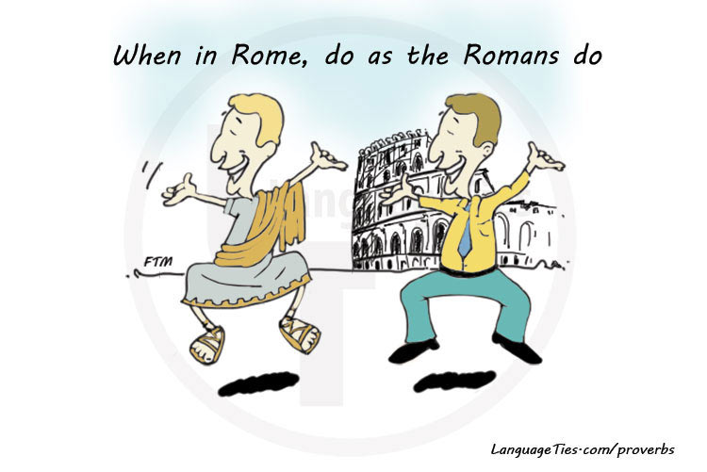
Risk Management
If you’re in an area operating with different principles, it is easiest to operate with their principles. (LanguageTies)
1st point Michael taught that although having risk is not desired, it is important not to be risk aversive to the point where one cannot make a decision. I have always disagreed with this notion because I have always thought that risk should be eliminated. However, with my thinking , the conclusion of this is that I cannot work on site because risk is always present and accidents happen. Michael’s suggestion ended up changing my mind, as I now see it is unreasonable to eliminate risk completely. I now see it is reasonable to work on site, as long as the risk is ALARP
2nd point Michael’s definition of ALARP also challenged my perception, because he defined it in terms of financial risk, where fraud was being assessed. He was saying fraud is acceptable as long as it is not big enough to compromise Alcoa’s reputation. I find it hard to accept this, but I understand that in some countries like my home country, bribery is common practice, and so business there are forced to operate with some degree of bribery, even a company like Alcoa’s ( The picture above describes the situation when operating in a foreign country). This definition of ALARP does not sit very well with me unfortunately.
3rd point Michael shared that Alcoa’s risk management is based on Excel, which was a surprise to me. This reinforced the importance of mastering the Office suite software, as they are used in even big companies like Woodside and now Alcoa . I am aiming to be familiar with these software before I graduate in 6 months time.
Reference
LanguageTies. When in Rome, Do as the Romans Do.
https://www.languageties.com/en/dictionary/when-in-rome-do-as-the-romans-do.

Slide 4
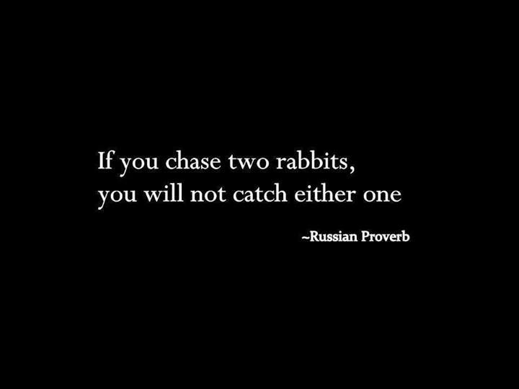
Project Management
Russian proverb (Thomas 2012)
1st point A point that Mr Venkatesh Iyer mentioned is that Project management is analogous to planning events in our own personal lives. I have been to project management workshops before, and I have struggled to get something from the classes because the ideas are quite unrelatable.
Mr Venkatesh’s illustration of planning for a friend’s birthday party made me understand how a project manager ought to prioritise activities. “Planning which mode of transport to use to get to the party is not as important as having the venue first”, He said. Whichever mode of transport used, you’ll still get there. But without securing the venue quite early, you may miss your objective of having the birthday party.
This point made me realise some of the things I do wrong as president of one of the Curtin engineering clubs. When planning for an event, I tend to try solving every concern that’s raised, where what I should really do is prioritise them, and address the most important first. It ends up that the event day comes before we’ve fully planned out everything, as we spent a big amount of time on trivial things. This is something I’m going to improve on.
2nd point Another key point that I got from Mr Venkatesh Iyer is the need to stay focused on the objective. One of the things I struggle with being in a leadership position is disagreeing with people and rejecting an idea. I fear that the person may take it personally and their reaction would be unpredictable.
But I have learnt that the objective gives a basis for accepting or rejecting an idea. The reason to reject is which idea is most focused on attaining the objective, and hence it is not my own opinion. I would try being sensitive when saying it, but if it is not aligned with the objective, then that option can no longer be considered. As the picture above illustrates, you cannot focus on the objective and also accepting everyone’s opinion, otherwise, you would end up meeting neither of the two.
References
Thomas, Steven. 2012. Focus – “If You Chase Two Rabbits, You Will Not Catch Either One”. http://itsadeliverything.com/focus-if-you-chase-two-rabbits-you-will-not-catch-either-one.

